Slide 1

Combining Artificial Intelligence and Cybersecurity to create a smart way to combat phishing threats
Meraj Hoque

Slide 2

Aim of the Project
Insert URLs of legitimate and phishing natures to see if an Artificial Intelligence model can provide correct and effective feedback

Slide 3

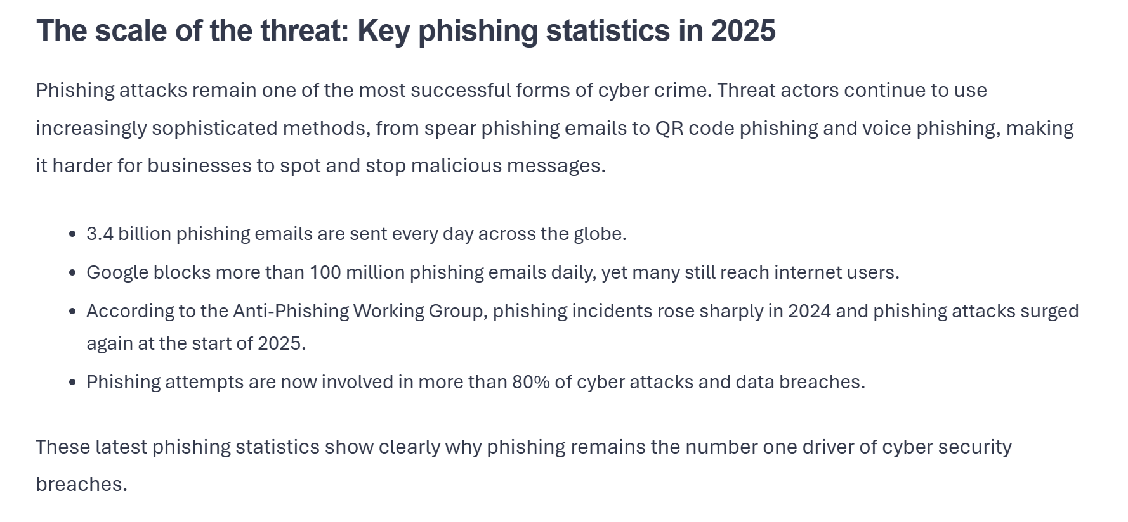
Problems to Solve
Protecting businesses and charities from phishing as they are the biggest targets of such a threat.
Everyday users are also susceptible to being deceived due to a lack of knowledge of the threat.
Introducing a smarter system that can keep up with Artificial Intelligence-driven attacks.

Slide 4
Objectives
Conduct research into existing phishing detection systems and see what gaps are in their systems that Artificial Intelligence can fill.
Fully implement an Artificial Intelligence model that correctly and quickly identifies URL’s that are a threat to users.
Display a user-friendly report of the systems analysis to the user to develop their understanding.

Slide 5
Objectives
Develop a testing table to effectively test all the features of my system.
Conduct participant testing to observe the effectiveness of the systems feedback.
Complete the dissertation

Slide 6
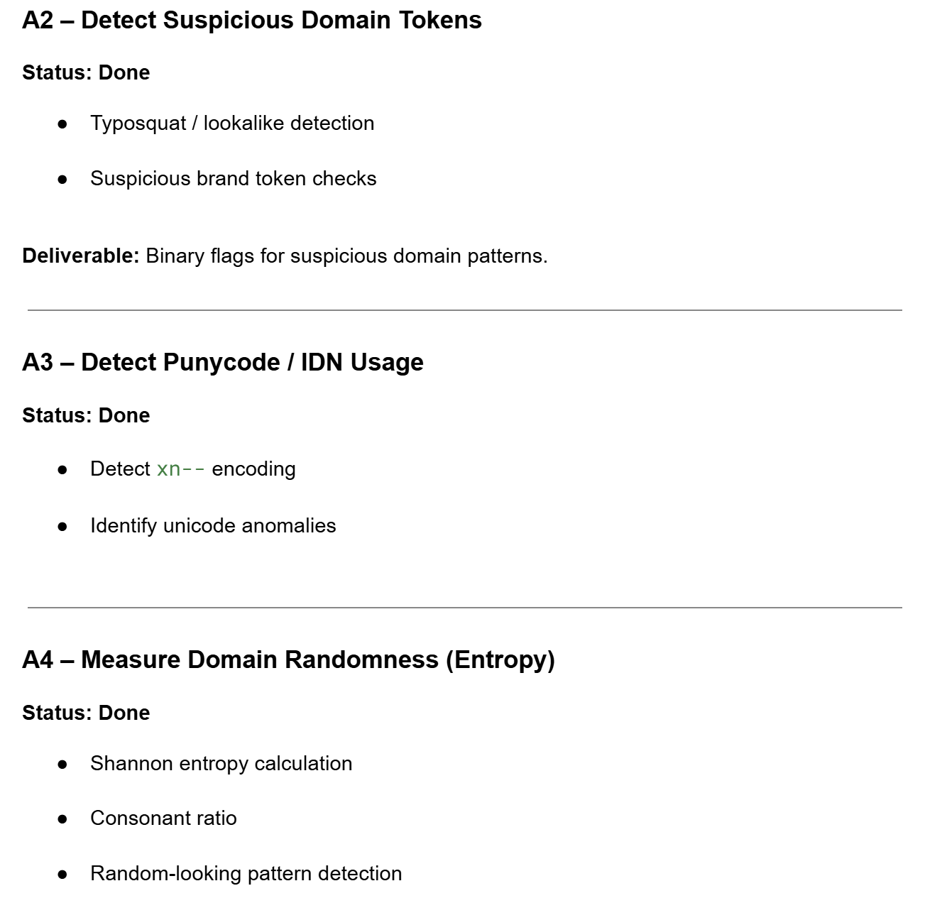
Approach and Organisation
I approached this project using a feature driven agile approach inspired by Feature-Driven Development (FDD).
Working in a feature focused way helped me stay focused and progress systematically.
Using a feature-driven methodology suited well with the long-term nature of the project.

Slide 7
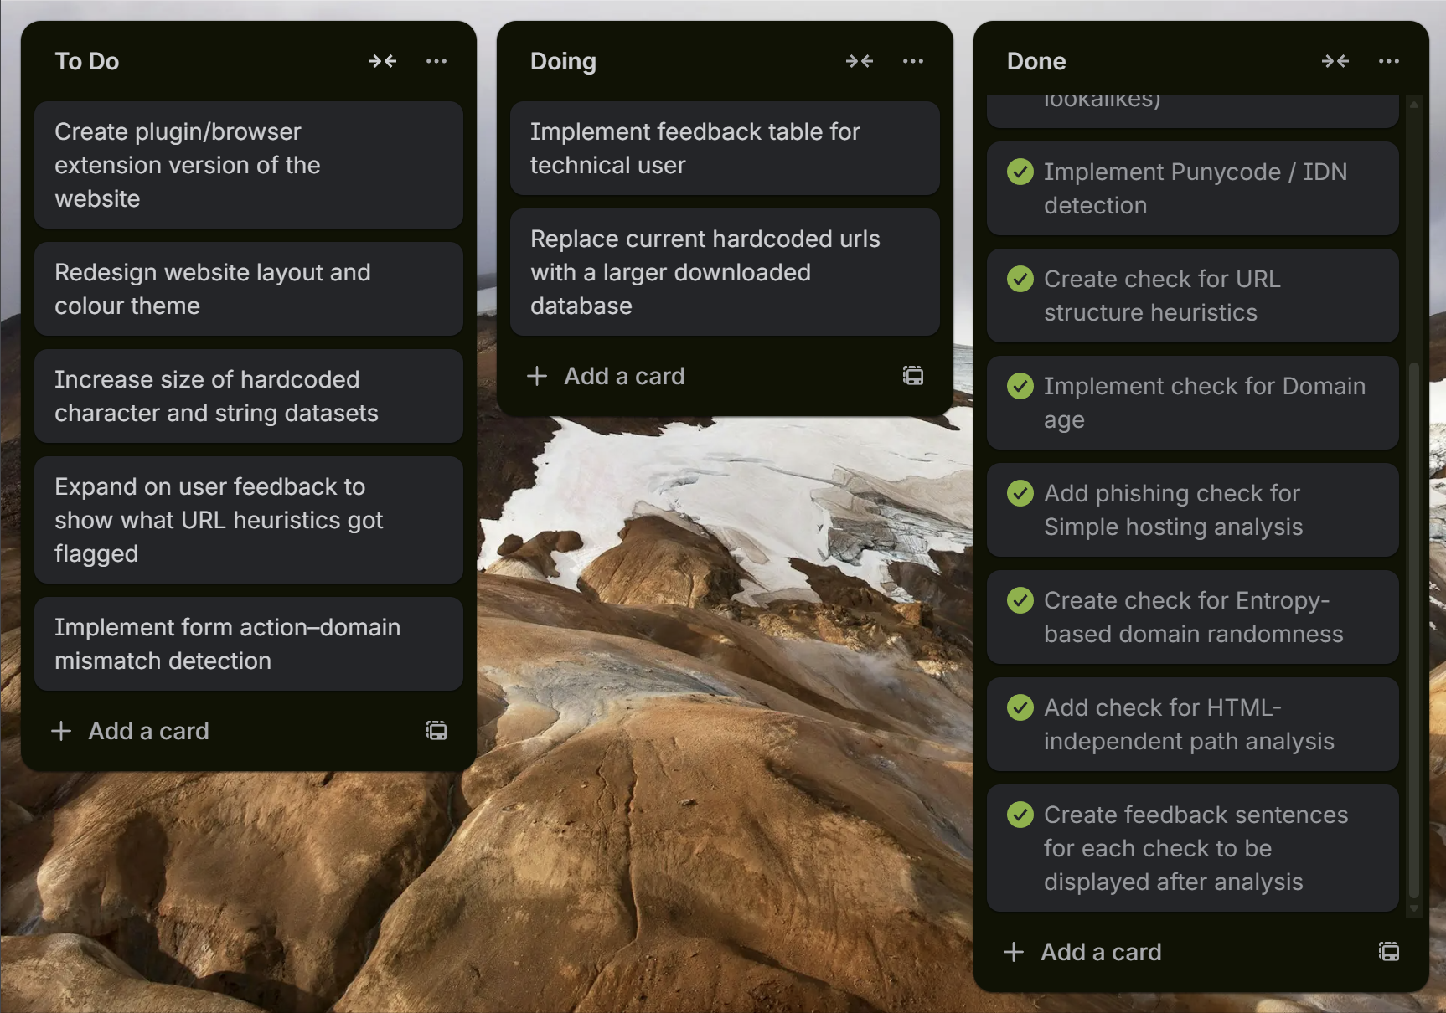
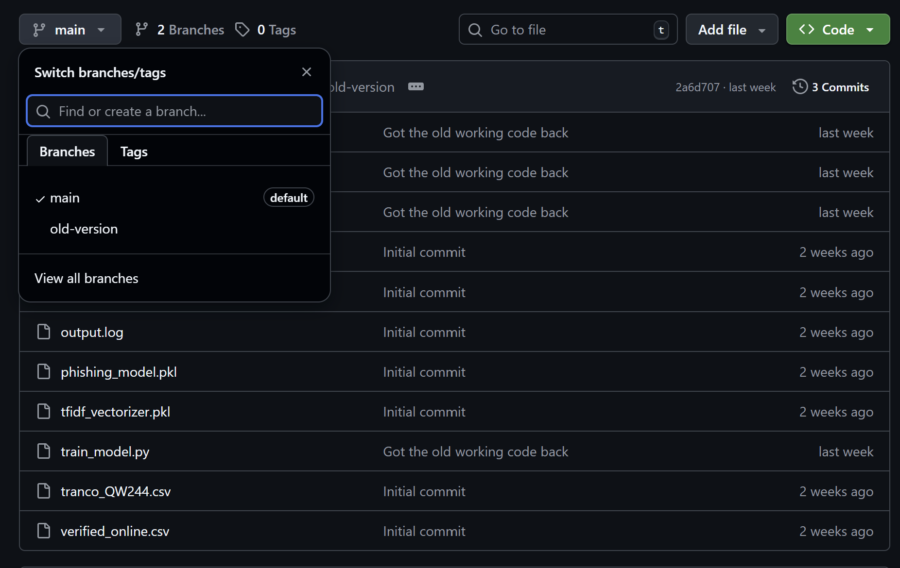
Approach and Organisation
I made use of a GitHub repository to store my code as it updated to ensure I have a backup in case anything went wrong.
I also made use of Trello as a checklist of all the features I was currently implementing and have already implemented.
I used a Google Doc to plan how I would create my project from the kinds of software I would use to the features I would be interested in coding.

Slide 8
Design of the Algorithm
A URL is inputted and multiple heuristic features combined with Term Frequency – Inverse Document Frequency (TF – IDF) features are extracted from it, numerical values are returned and a feature vector is formed with them.
A RandomForestClassifier model is used where 200 decision trees are established to use the feature vector to decide on whether the URL is phishing or legitimate.

Slide 9
Design of the Algorithm
During runtime, the extracted features are processed in memory and used directly by the trained model to generate a prediction.
Alongside the verdict, the estimated probability is displayed as confidence, and predefined rule-based explanations are generated based on the heuristic values detected in the URL.

Slide 10
Implementation
My project is being programmed in Python and HTML . I used Visual Studio Code as my coding environment
I also used Anaconda which helped manage my Python environment and dependencies and most importantly reliably run machine-learning libraries like NumPy, Pandas, and scikit-learn without compatibility issues.
I also used Flask to build the web interface my project is being ran on.

Slide 11
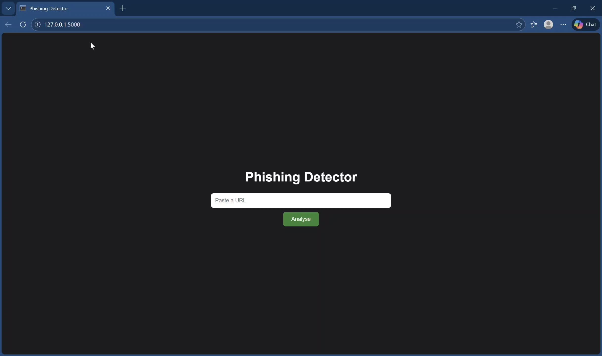
Video of Testing

Slide 12
Testing
Creating a test plan to effectively test all the key functions of my project and ensure they work as planned.
I am going to conduct participant testing to see the effectiveness of the systems feedback and whether users are confident in the systems ability.
I have done research into websites I can gather URLs to test the Artificial Intelligences ability in correctly judging the nature of the URLs being inputted.

Slide 13
Things I Have Completed
Coded all the checks I want to perform on the URL
Gave the Artificial Intelligence model the ability to judge the results on the vector and decide.
Outputs the verdict made by the Artificial Intelligence model alongside a confidence assessment.
Outputs a small paragraph explaining why the assessment was made.

Slide 14
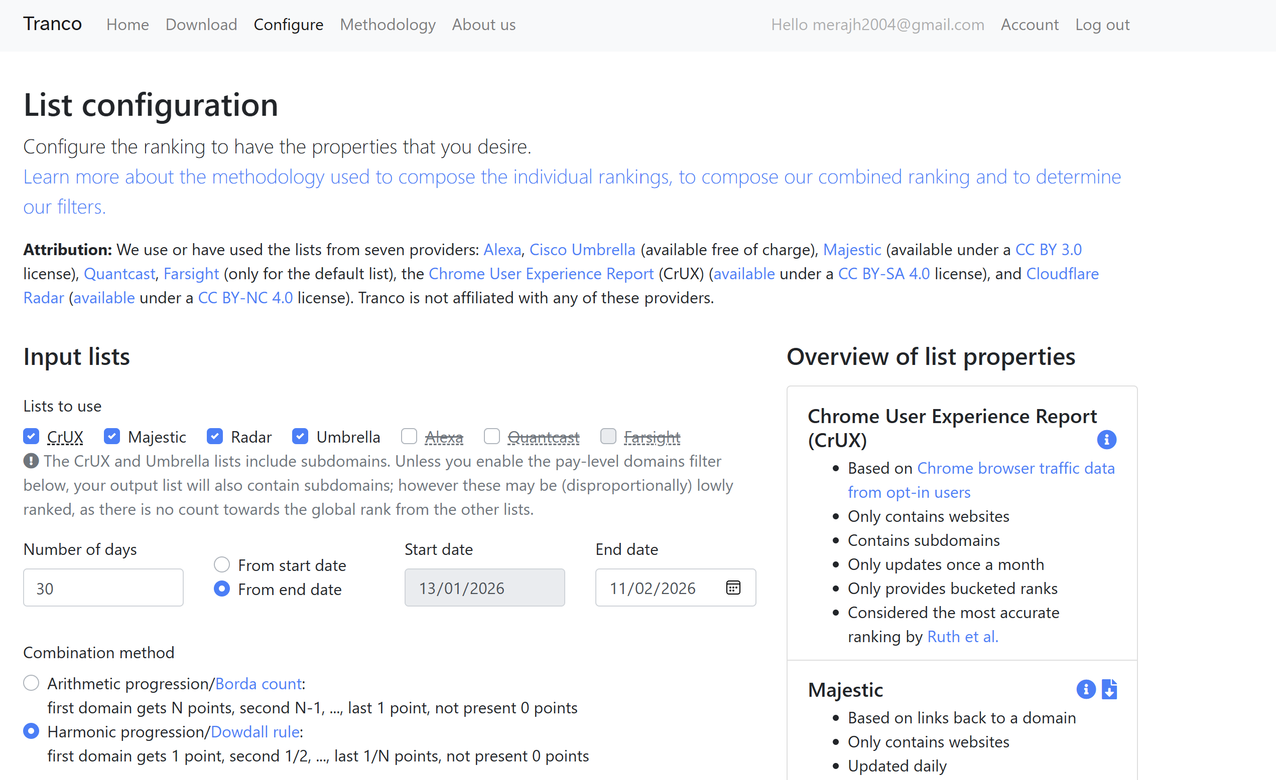
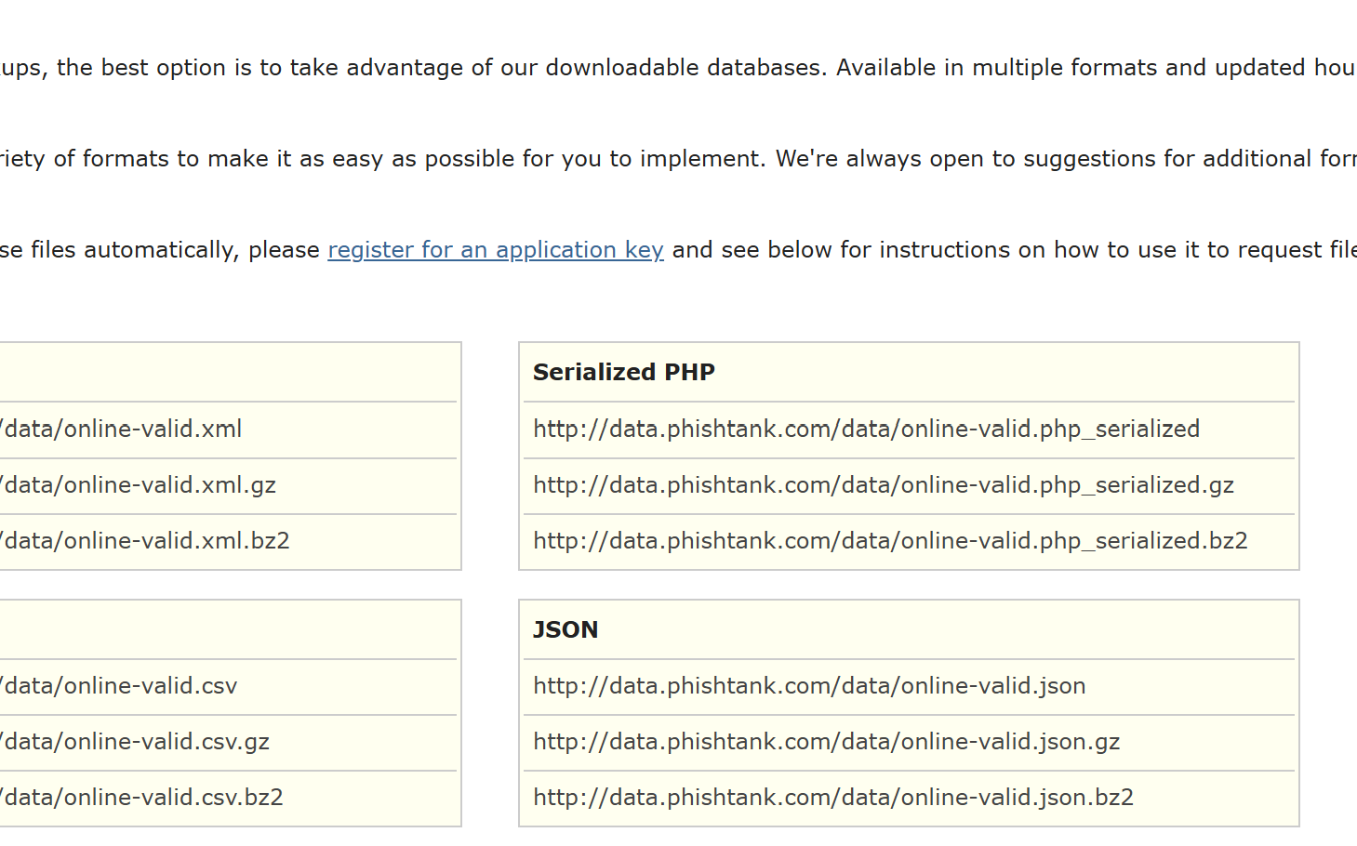
What I’m Currently Working On
I’m currently researching about adding datasets containing roughly 50,000 URLs to replace my hardcoded phishing and legitimate URLs.
Researching values to display on a report technical users can look at after analysis of the URL is complete.

Slide 15
Things I’m Hoping To Work On
Building a mini plugin version of the website
Introducing a more advanced check that significantly strengthens the system, such as form action–domain mismatch detection.
Designing a small feature that outputs the specific URL checks that the Artificial Intelligence model flagged for the URL.

Slide 16
Evaluation
Roughly 5 participants
Consent forms will be signed to start the evaluation
A timer will be started as participants will have up to 5 minutes to navigate the website and gain feedback on the URL they pasted
Once the participant is satisfied with exploring the system or the timer has ended, a questionnaire will be handed to them
Their responses to the questionnaire will be used to see if the participant understood feedback, if they felt the website was lacking any information/features and if they are confident in the systems ability.

